Slide 1
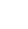

SQUID
GAME
Tweet Sentiment Analysis
WINDA SHANIA F

Slide 2

1
BUSINESS UNDERSTANDING
ADJUST MARKETING STRATEGI
IMPROVE CAMPAIGN TARGETING, ENGAGEMENT
GAIN INSIGHT TO ENCHANCING AUDIENCE SATISFACTION AND LOYALTY

Slide 3
BACKGROUND
Public reviews can provide insights into the quality of a movie, and consumers may prefer to know others' opinions or reviews about a film before deciding to watch it (Kim, A., 2021).

Slide 4
PROBLEM STATEMENT
OBJECTIVE
How are positive and negative reviews distributed among viewers?
What are the common topics discussed by viewers?
How can we automate the process of classifying sentiments in tweets?
Identify common feedback from viewers.
Generate insights that can be used for business decisions or marketing strategies.
Build a classification model to automate tweet sentiment classification.

Slide 5
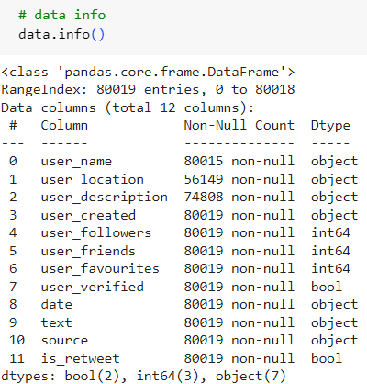
2
DATA OVERVIEW
The dataset consist of
12 columns and 80019 rows
Missing value in location ~30%
Missing value in description ~6%

Slide 6
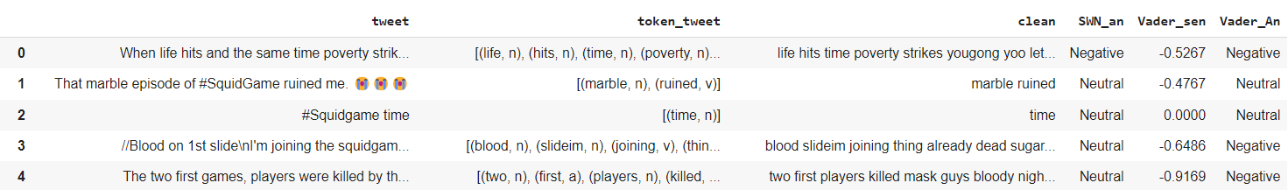
3
DATA PREPROCESSING
TEXT PREPOCESSING
Remove unsignificant symbol in text
Remove irrelevant words manually from wordcloud
Remove stop words
Lemmatize words using library

Slide 7
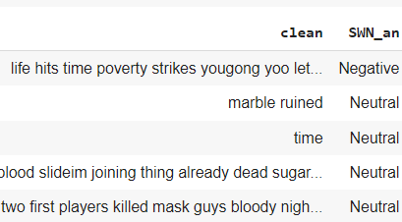
LABELING
analyzer = SentimentIntensityAnalyzer()
sentiment = Negative, Positve, Neutral

Slide 8
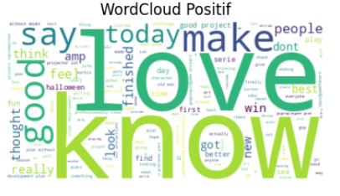
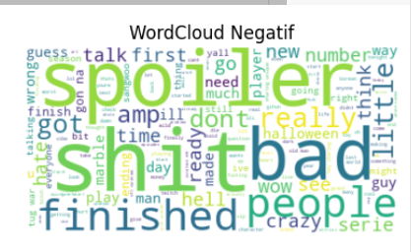
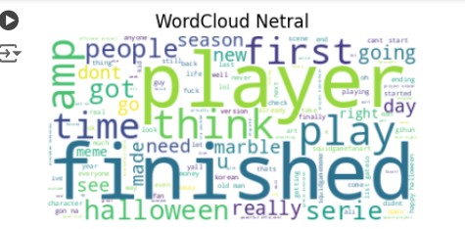
WORDCLOUD

Slide 9
4
EDA
TEXT PREPOCESSING
Remove unsignificant symbol in text
Remove irrelevant words manually from wordcloud
Remove stop words
Lemmatize words using library

Slide 10
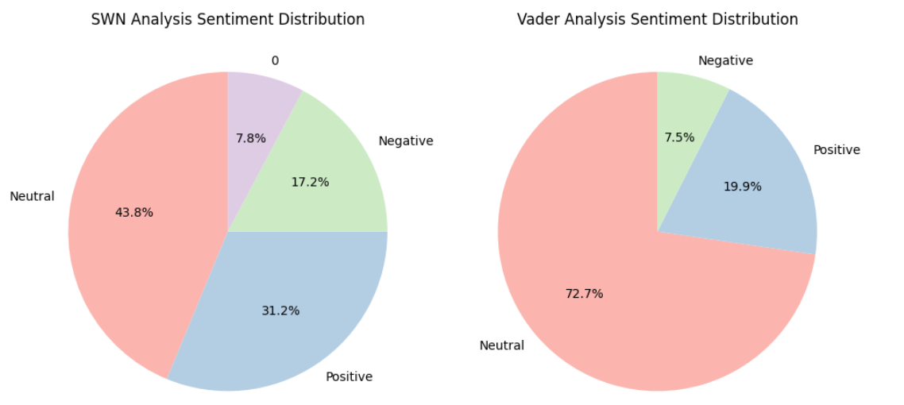
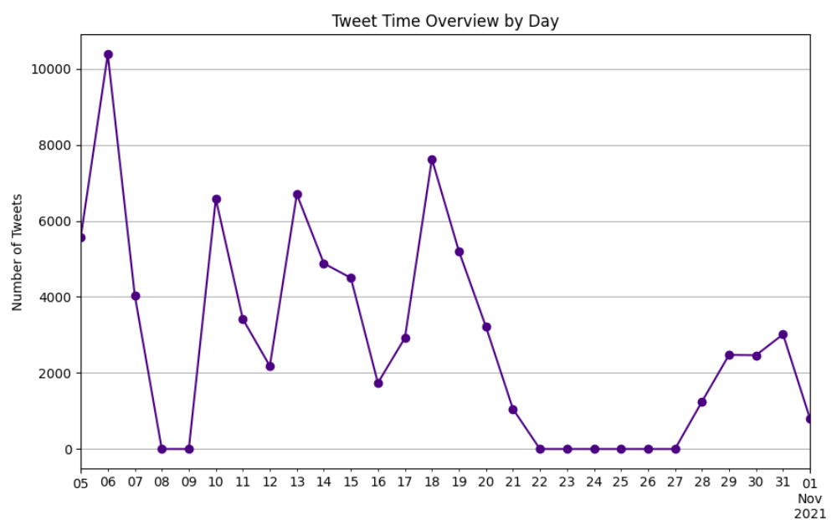
Top 3 Most Tweet
day 6 12% (10.381) tweet
day 18 9,5% (7.624) tweet
day 13 8,3% (6.699) tweet
4
EDA
Positive and neutral sentiment > negative sentiment = audience satisfied with the movie

Slide 11
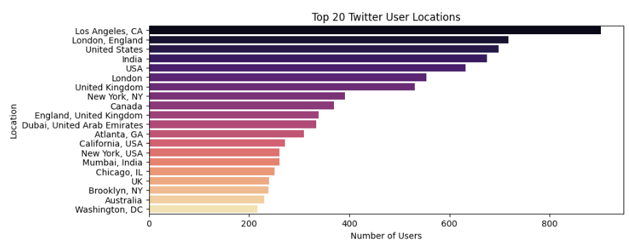
4
EDA
audience mostly from America

Slide 12
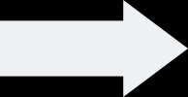
5
MODELING AND EVAL
FEATURE EXTRACTION
DATA SPLIT
MODEL TRAIN
CROSS VALIDATION
COMPARSION MODEL
MODEL EVALUATION

Slide 13
5
SPLIT DATA
FEATURE_EXTRACTION
TARGET
MODEL
80 : 20
TFIDF - SELECTKBEST (N-GRAM)
SENTIMENT (1 = + ; 0 = -)
N-GRAM LOGISTIC REGRESSION
/ NB / RANDOM FOREST

Slide 14




MODEL EVALUATION
LOGREG
(accuracy)
unigram (93%)
bigram (91%)
u + b + fs (85%)
MNAIVE BAYES
(accuracy)
78%
RANDOM FOREST
(accuracy)
95%

Slide 15
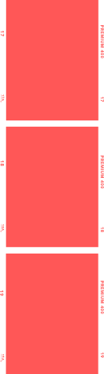

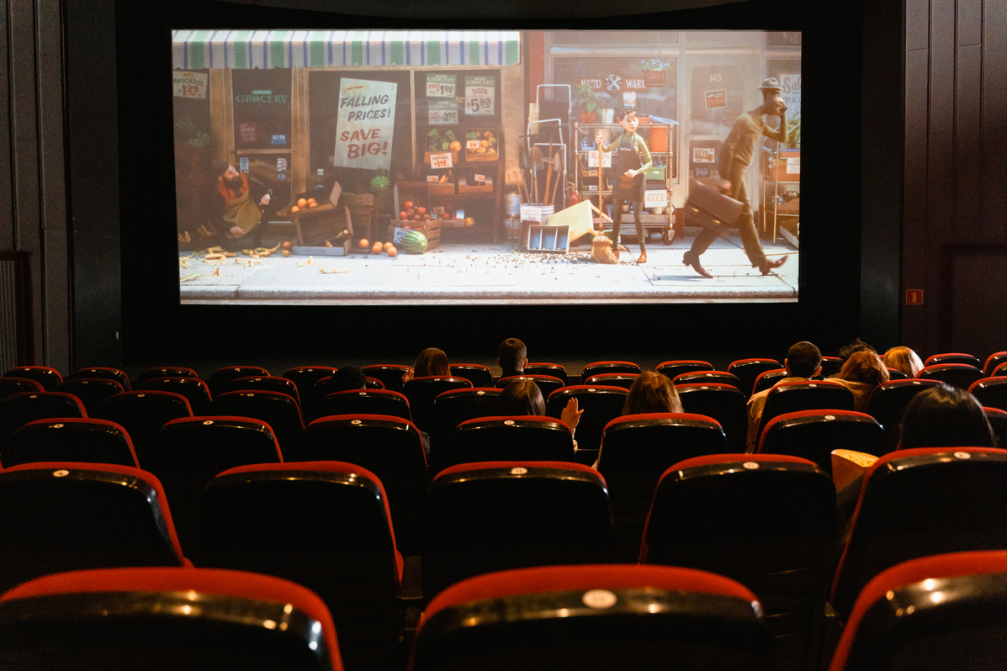



FINAL MODEL
BEST MODEL : Random Forest and Logistic Regression
BEST PARAMETER : NGRAM (1,2)

Slide 16
Targeted Marketing Campaigns: Use positive sentiment and high ratings to create targeted ads on social media platforms, focusing on American audiences to maximize engagement and viewership.
BUSINESS RECOMMENDATION
Spoiler-Free Community Platform: Develop a platform or section dedicated to spoiler-free discussions to enhance user experience and retain viewers who dislike spoilers.

Slide 17

THANKS

